Slide 1
Programming
J. Michael Moore
CSCE 121

Slide 2
Programming
Discovering how, in principle, a problem can be solved by a computer
Translating this solution into a form (a program, or software) that can be executed by a computer

Slide 3
Our civilization runs on software
Most engineering activities involve software
Most programs do not run on things that look like a PC…

Slide 4


Aircraft
Communication
Control
Display
Signal Processing
Monitoring

Slide 5
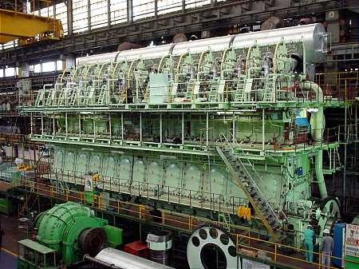
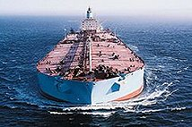
Ships
Design
Construction
Management
Monitoring
Hull Design
Pumps

Slide 6
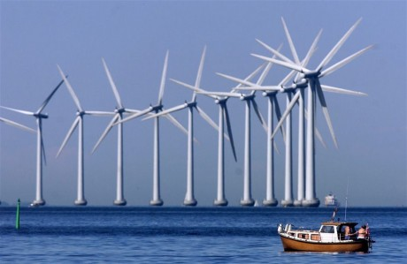

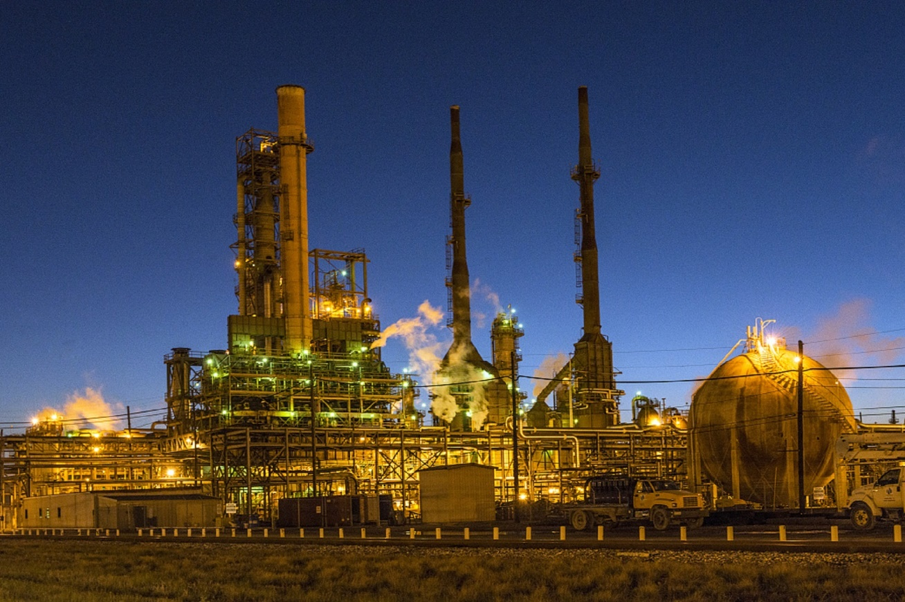
Energy
Control
Monitoring
Analysis
Design
Communications
Manufacturing
Vizualization

Slide 7
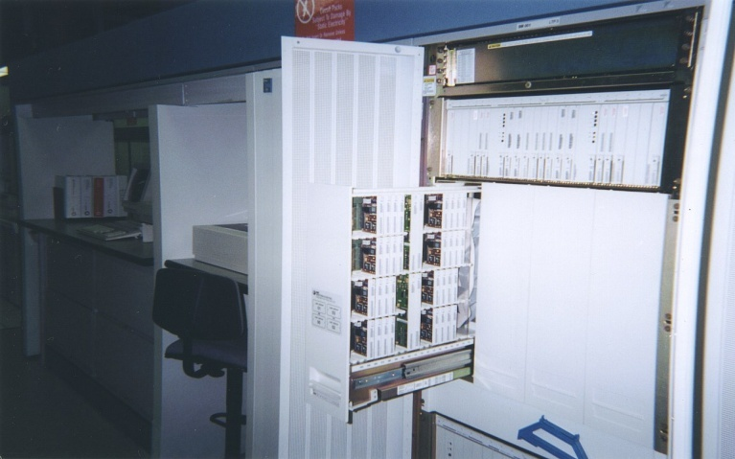
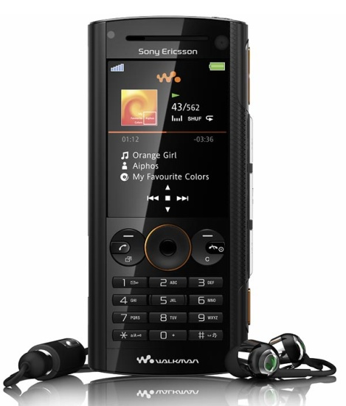

Phones
Voice Quality
User Interfaces
Billing
Mobility
Switching
Reliability
Provisioning
Images

Slide 8
C++ allows direct expression of ideas from many application areas
C++ is most widely used language in engineering areas
C++ is precisely and completely defined by an ISO standard
C++ is widely available
Concepts you learn with C++ are directly applicable to many other languages

Slide 9
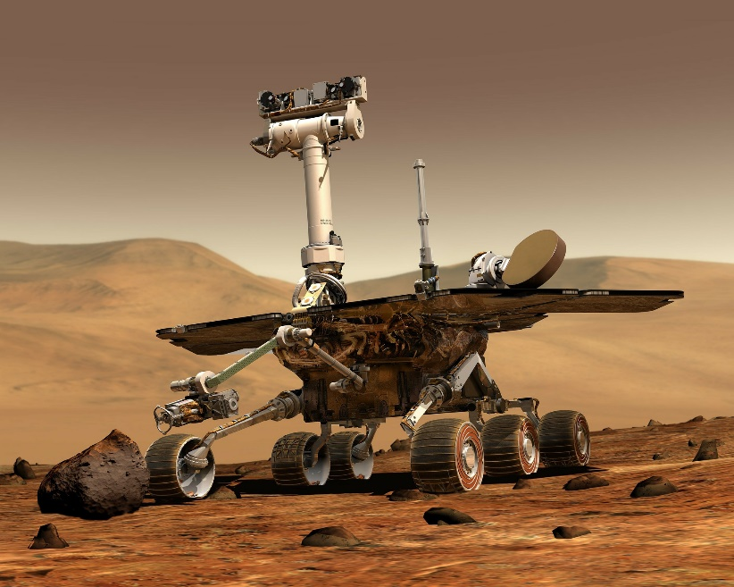

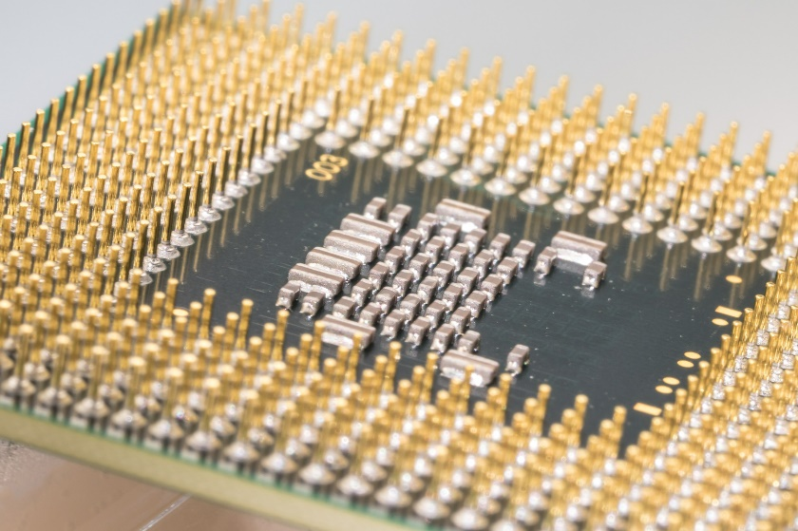
Where is C++ Used
Mars Rovers,
Animation,
Graphics,
Photoshop,
GUIs,
Embedded Systems,
OS’s, Compilers, Slides, Chip Design, Chip Manufacturing, Semiconductor Tools,…

Slide 10
Programming Language Tree
https://ccrma.stanford.edu/courses/250a-fall-2005/docs/ComputerLanguagesChart.png

Slide 11
Who are programmers…

Slide 12
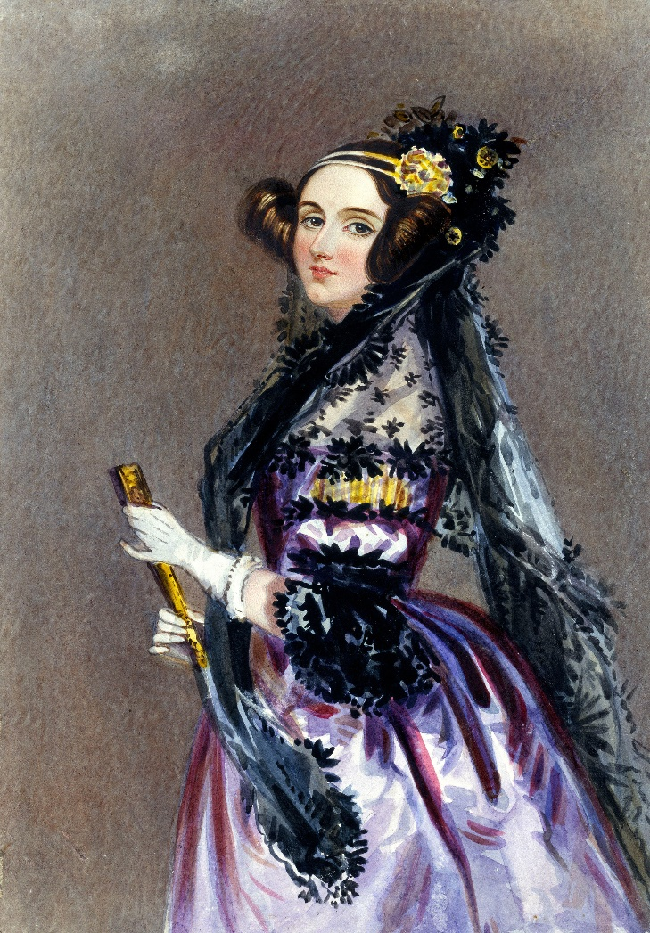
Ada Lovelace
“First Computer Programmer”
Born 1815
Worked with Charles Babbage
"Ada Lovelace portrait" by Alfred Edward Chalon - Science & Society Picture Library. Licensed under Public Domain via Commons

Slide 13
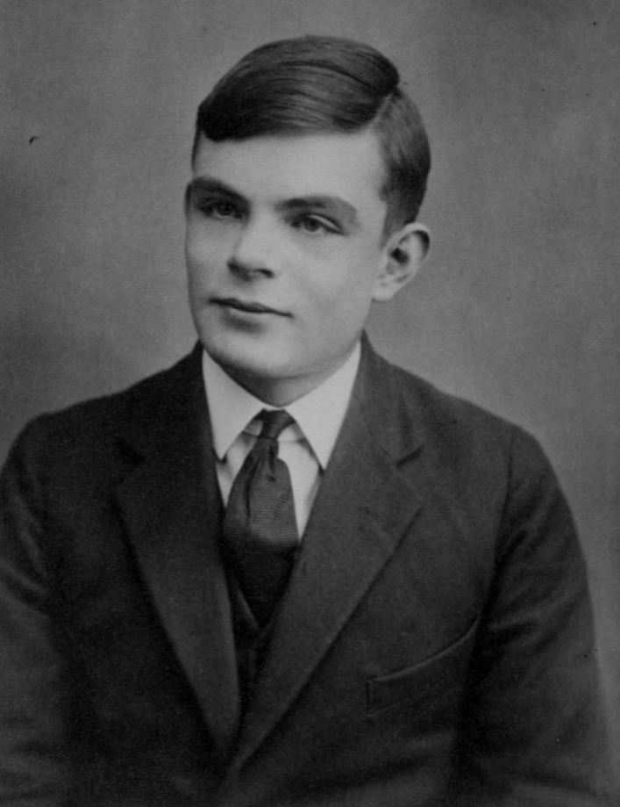
Alan Turing
British
Formalized idea of algorithm and computation
WWII codebreaker
Turing Award named in his honor
Three movies about him…
Prosecuted for being gay
"Sackville Park Turing plaque" by User Lmno on en.wikipedia - Photograph taken by Lmno. Licensed under CC BY-SA 3.0 via Commons
"Alan Turing Aged 16" by Unknown
Licensed under Public Domain via Commons

Slide 14
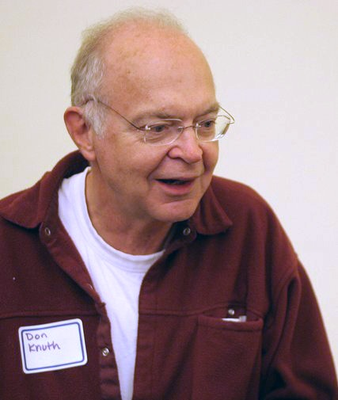
Donald Knuth
The Art of Computer Programming
Father of analysis of algorithms
Popularized asymptotic notation
Creator of Tex
"KnuthAtOpenContentAlliance" by Flickr user Jacob Appelbaum,
uploaded to en.wikipedia by users BeSherman, Duozmo - Flickr.com (via en.wikipedia).
Licensed under CC BY-SA 2.5 via Commons

Slide 15
Acknowledgement
Based on slides created by Bjarne Stroustrup and Jennifer Welch
Many images from pixabay.com

Slide 16
Computer Organization & Compilation Process
CSCE 121
J. Michael Moore

Slide 17
Simplified Model
Input
Processor
Output
Memory
Abstraction

Slide 18
Memory
Usually stored in RAM
Composed of ones and zeroes
Address for each byte (group of 8 bits)
Physical Address
Logical Address
Starts at zero

Slide 19
Memory Layout
Memory
Code
Static Data
Heap / Free Store
Stack and heap grow toward each other.
Heap / Free Store
Stack
Stack

Slide 20
Compilation Process
Starting with source code (e.g. C++) and converting it into machine code that the computer can run.
When using our IDE, the process appears like this:
Source Code
Compile
Executable File

Slide 21
Actual Process
Source Code
Assembler
Assembler File
Compiler
Object Code File
Linker
Executable File
Expanded Source Code
C++ Preprocessor
#included header files
Object Code for Library Functions
http://faculty.cs.niu.edu/~mcmahon/CS241/Notes/compile.html

Slide 22
Variables with Memory Diagram
CSCE 121
J. Michael Moore

Slide 23
Some Definitions
Object: region of memory with a type that specifies what kind of information can be stored there and what operations can be performed on it
Variable: object with a name
Declaration: statement that gives a name to an object
Definition: declaration that also sets aside memory for a variable
Value: data item put into a variable
Notes:
For these simple variable examples, declaration and definition are the same.

Slide 24
Names / Identifiers
For variables, functions, types, …
Rules:
Start with a letter
Only composed of letters, digits and underscores (_)
Cannot use keywords (e.g. int, if, while, double)

Slide 25
Variables
Identifier is associated with a specific location in memory (i.e. address).
Use them in programs as if they were the value.
In the background, the compiler sets things up to dereference the variable identifier (i.e. get the value held in the address).
The variable type dictates how the bits will be interpreted. (More on types later…)

Slide 26
Declaration, Definition, & Initialization
Declare
Say what an identifier is and what type of object it refers to.
Connects a name to an object.
Define
Sets aside memory.
Initialize
Set value held in identifier for the first time.
Note zyBook conflates Declaration and Definition, but they are DIFFERENT!

Slide 27
Examples
int z; (declaration and definition)
extern int z; (declaration)
This is rare for variables of base types. (i.e. we won’t do this…)
int z = 7; (declaration, definition, and initialization)

Slide 28
Memory Diagram
It is not helpful for us to refer to specific addresses. We tend to think symbolically about the data.
For example we think about x times x
rather than thinking x refers to a memory address and if we get the value held at that address and multiply it by that value…
Memory diagrams allow us to think about the variables we are using in a program without having to worry about specific memory addresses.
They can also help us do ‘hand execution’ of the code.

Slide 29
Program
#include <iostream>
#include <string>
using namespace std;
int main() {
int rank = 15;
int classSize = 35;
double score1 = 82.45;
double score2 = 95.25;
double average = (score1 + score2) / 2;
char grade = 'C';
rank = 7;
grade = 'B';
string name = "Michael";
cout << "Name: " << name << endl;
cout << "Average: " << average << endl;
cout << "Rank: " << rank << " of ";
cout << classSize << endl;
cout << "Grade: " << grade << endl;
}

Slide 30
Program
Set up memory diagram…
An area for the stack and an area for identifiers…
#include <iostream>
#include <string>
using namespace std;
int main() {
int rank = 15;
int classSize = 35;
double score1 = 82.45;
double score2 = 95.25;
double average = (score1 + score2) / 2;
char grade = 'C';
rank = 7;
grade = 'B';
string name = "Michael";
cout << "Name: " << name << endl;
cout << "Average: " << average << endl;
cout << "Rank: " << rank << " of ";
cout << classSize << endl;
cout << "Grade: " << grade << endl;
}
identifier
stack

Slide 31
Program
output
Set up area to write output…
#include <iostream>
#include <string>
using namespace std;
int main() {
int rank = 15;
int classSize = 35;
double score1 = 82.45;
double score2 = 95.25;
double average = (score1 + score2) / 2;
char grade = 'C';
rank = 7;
grade = 'B';
string name = "Michael";
cout << "Name: " << name << endl;
cout << "Average: " << average << endl;
cout << "Rank: " << rank << " of ";
cout << classSize << endl;
cout << "Grade: " << grade << endl;
}
identifier
stack

Slide 32
Program
output
We will identify the name of the function (only main for now).
#include <iostream>
#include <string>
using namespace std;
int main() {
int rank = 15;
int classSize = 35;
double score1 = 82.45;
double score2 = 95.25;
double average = (score1 + score2) / 2;
char grade = 'C';
rank = 7;
grade = 'B';
string name = "Michael";
cout << "Name: " << name << endl;
cout << "Average: " << average << endl;
cout << "Rank: " << rank << " of ";
cout << classSize << endl;
cout << "Grade: " << grade << endl;
}
main
identifier
stack

Slide 33
Program
output
Note: We don’t know what value rank holds. It could be any random values for its bits. When we initialize we set it to a known value!
Add variable identifiers as we encounter them…
#include <iostream>
#include <string>
using namespace std;
int main() {
int rank = 15;
int classSize = 35;
double score1 = 82.45;
double score2 = 95.25;
double average = (score1 + score2) / 2;
char grade = 'C';
rank = 7;
grade = 'B';
string name = "Michael";
cout << "Name: " << name << endl;
cout << "Average: " << average << endl;
cout << "Rank: " << rank << " of ";
cout << classSize << endl;
cout << "Grade: " << grade << endl;
}
main
rank
?
identifier
stack

Slide 34
Program
output
Set values when assigned…
Note: This is first value assigned so it is initialization.
#include <iostream>
#include <string>
using namespace std;
int main() {
int rank = 15;
int classSize = 35;
double score1 = 82.45;
double score2 = 95.25;
double average = (score1 + score2) / 2;
char grade = 'C';
rank = 7;
grade = 'B';
string name = "Michael";
cout << "Name: " << name << endl;
cout << "Average: " << average << endl;
cout << "Rank: " << rank << " of ";
cout << classSize << endl;
cout << "Grade: " << grade << endl;
}
main
rank
15
identifier
stack

Slide 35
Program
output
#include <iostream>
#include <string>
using namespace std;
int main() {
int rank = 15;
int classSize = 35;
double score1 = 82.45;
double score2 = 95.25;
double average = (score1 + score2) / 2;
char grade = 'C';
rank = 7;
grade = 'B';
string name = "Michael";
cout << "Name: " << name << endl;
cout << "Average: " << average << endl;
cout << "Rank: " << rank << " of ";
cout << classSize << endl;
cout << "Grade: " << grade << endl;
}
main
classSize
35
rank
15
identifier
stack

Slide 36
Program
output
#include <iostream>
#include <string>
using namespace std;
int main() {
int rank = 15;
int classSize = 35;
double score1 = 82.45;
double score2 = 95.25;
double average = (score1 + score2) / 2;
char grade = 'C';
rank = 7;
grade = 'B';
string name = "Michael";
cout << "Name: " << name << endl;
cout << "Average: " << average << endl;
cout << "Rank: " << rank << " of ";
cout << classSize << endl;
cout << "Grade: " << grade << endl;
}
main
score1
82.45
classSize
35
rank
15
identifier
stack

Slide 37
Program
output
#include <iostream>
#include <string>
using namespace std;
int main() {
int rank = 15;
int classSize = 35;
double score1 = 82.45;
double score2 = 95.25;
double average = (score1 + score2) / 2;
char grade = 'C';
rank = 7;
grade = 'B';
string name = "Michael";
cout << "Name: " << name << endl;
cout << "Average: " << average << endl;
cout << "Rank: " << rank << " of ";
cout << classSize << endl;
cout << "Grade: " << grade << endl;
}
main
score2
95.25
score1
82.45
classSize
35
rank
15
identifier
stack

Slide 38
Program
output
#include <iostream>
#include <string>
using namespace std;
int main() {
int rank = 15;
int classSize = 35;
double score1 = 82.45;
double score2 = 95.25;
double average = (score1 + score2) / 2;
char grade = 'C';
rank = 7;
grade = 'B';
string name = "Michael";
cout << "Name: " << name << endl;
cout << "Average: " << average << endl;
cout << "Rank: " << rank << " of ";
cout << classSize << endl;
cout << "Grade: " << grade << endl;
}
average
88.85
main
score2
95.25
score1
82.45
classSize
35
rank
15
identifier
stack

Slide 39
Program
output
#include <iostream>
#include <string>
using namespace std;
int main() {
int rank = 15;
int classSize = 35;
double score1 = 82.45;
double score2 = 95.25;
double average = (score1 + score2) / 2;
char grade = 'C';
rank = 7;
grade = 'B';
string name = "Michael";
cout << "Name: " << name << endl;
cout << "Average: " << average << endl;
cout << "Rank: " << rank << " of ";
cout << classSize << endl;
cout << "Grade: " << grade << endl;
}
grade
C
average
88.85
main
score2
95.25
score1
82.45
classSize
35
rank
15
identifier
stack

Slide 40
Program
output
When assigned a new value, cross out old value and write in new value.
#include <iostream>
#include <string>
using namespace std;
int main() {
int rank = 15;
int classSize = 35;
double score1 = 82.45;
double score2 = 95.25;
double average = (score1 + score2) / 2;
char grade = 'C';
rank = 7;
grade = 'B';
string name = "Michael";
cout << "Name: " << name << endl;
cout << "Average: " << average << endl;
cout << "Rank: " << rank << " of ";
cout << classSize << endl;
cout << "Grade: " << grade << endl;
}
grade
C
average
88.85
main
score2
95.25
score1
82.45
classSize
35
rank
15
7
identifier
stack

Slide 41
Program
output
#include <iostream>
#include <string>
using namespace std;
int main() {
int rank = 15;
int classSize = 35;
double score1 = 82.45;
double score2 = 95.25;
double average = (score1 + score2) / 2;
char grade = 'C';
rank = 7;
grade = 'B';
string name = "Michael";
cout << "Name: " << name << endl;
cout << "Average: " << average << endl;
cout << "Rank: " << rank << " of ";
cout << classSize << endl;
cout << "Grade: " << grade << endl;
}
grade
C
B
average
88.85
main
score2
95.25
score1
82.45
classSize
35
rank
15
7
identifier
stack

Slide 42
Program
output
#include <iostream>
#include <string>
using namespace std;
int main() {
int rank = 15;
int classSize = 35;
double score1 = 82.45;
double score2 = 95.25;
double average = (score1 + score2) / 2;
char grade = 'C';
rank = 7;
grade = 'B';
string name = "Michael";
cout << "Name: " << name << endl;
cout << "Average: " << average << endl;
cout << "Rank: " << rank << " of ";
cout << classSize << endl;
cout << "Grade: " << grade << endl;
}
name
Michael
grade
C
B
average
88.85
main
score2
95.25
score1
82.45
classSize
35
rank
15
7
identifier
stack

Slide 43
Program
output
Now start output…
Note: endl means go to a new line
Name:
Michael
#include <iostream>
#include <string>
using namespace std;
int main() {
int rank = 15;
int classSize = 35;
double score1 = 82.45;
double score2 = 95.25;
double average = (score1 + score2) / 2;
char grade = 'C';
rank = 7;
grade = 'B';
string name = "Michael";
cout << "Name: " << name << endl;
cout << "Average: " << average << endl;
cout << "Rank: " << rank << " of ";
cout << classSize << endl;
cout << "Grade: " << grade << endl;
}
name
Michael
grade
C
B
average
88.85
main
score2
95.25
score1
82.45
classSize
35
rank
15
7
identifier
stack

Slide 44
Program
output
Name:
Michael
Average:
88.85
#include <iostream>
#include <string>
using namespace std;
int main() {
int rank = 15;
int classSize = 35;
double score1 = 82.45;
double score2 = 95.25;
double average = (score1 + score2) / 2;
char grade = 'C';
rank = 7;
grade = 'B';
string name = "Michael";
cout << "Name: " << name << endl;
cout << "Average: " << average << endl;
cout << "Rank: " << rank << " of ";
cout << classSize << endl;
cout << "Grade: " << grade << endl;
}
name
Michael
grade
C
B
average
88.85
main
score2
95.25
score1
82.45
classSize
35
rank
15
7
identifier
stack

Slide 45
Program
output
Name:
Michael
Average:
88.85
Rank:
7
of
#include <iostream>
#include <string>
using namespace std;
int main() {
int rank = 15;
int classSize = 35;
double score1 = 82.45;
double score2 = 95.25;
double average = (score1 + score2) / 2;
char grade = 'C';
rank = 7;
grade = 'B';
string name = "Michael";
cout << "Name: " << name << endl;
cout << "Average: " << average << endl;
cout << "Rank: " << rank << " of ";
cout << classSize << endl;
cout << "Grade: " << grade << endl;
}
name
Michael
grade
C
B
average
88.85
main
score2
95.25
score1
82.45
classSize
35
rank
15
7
identifier
stack

Slide 46
Program
output
Name:
Michael
Average:
88.85
Rank:
7
of
35
#include <iostream>
#include <string>
using namespace std;
int main() {
int rank = 15;
int classSize = 35;
double score1 = 82.45;
double score2 = 95.25;
double average = (score1 + score2) / 2;
char grade = 'C';
rank = 7;
grade = 'B';
string name = "Michael";
cout << "Name: " << name << endl;
cout << "Average: " << average << endl;
cout << "Rank: " << rank << " of ";
cout << classSize << endl;
cout << "Grade: " << grade << endl;
}
name
Michael
grade
C
B
average
88.85
main
score2
95.25
score1
82.45
classSize
35
rank
15
7
identifier
stack

Slide 47
Program
output
Name:
Michael
Average:
88.85
Rank:
7
of
35
#include <iostream>
#include <string>
using namespace std;
int main() {
int rank = 15;
int classSize = 35;
double score1 = 82.45;
double score2 = 95.25;
double average = (score1 + score2) / 2;
char grade = 'C';
rank = 7;
grade = 'B';
string name = "Michael";
cout << "Name: " << name << endl;
cout << "Average: " << average << endl;
cout << "Rank: " << rank << " of ";
cout << classSize << endl;
cout << "Grade: " << grade << endl;
}
Grade:
B
name
Michael
grade
C
B
average
88.85
main
score2
95.25
score1
82.45
classSize
35
rank
15
7
identifier
stack

Slide 48
A tool
Memory diagrams are only a tool.
Usually do them on scratch paper.
On an exam, make legible.
The next slide is an example of what this example might really look like…

Slide 49
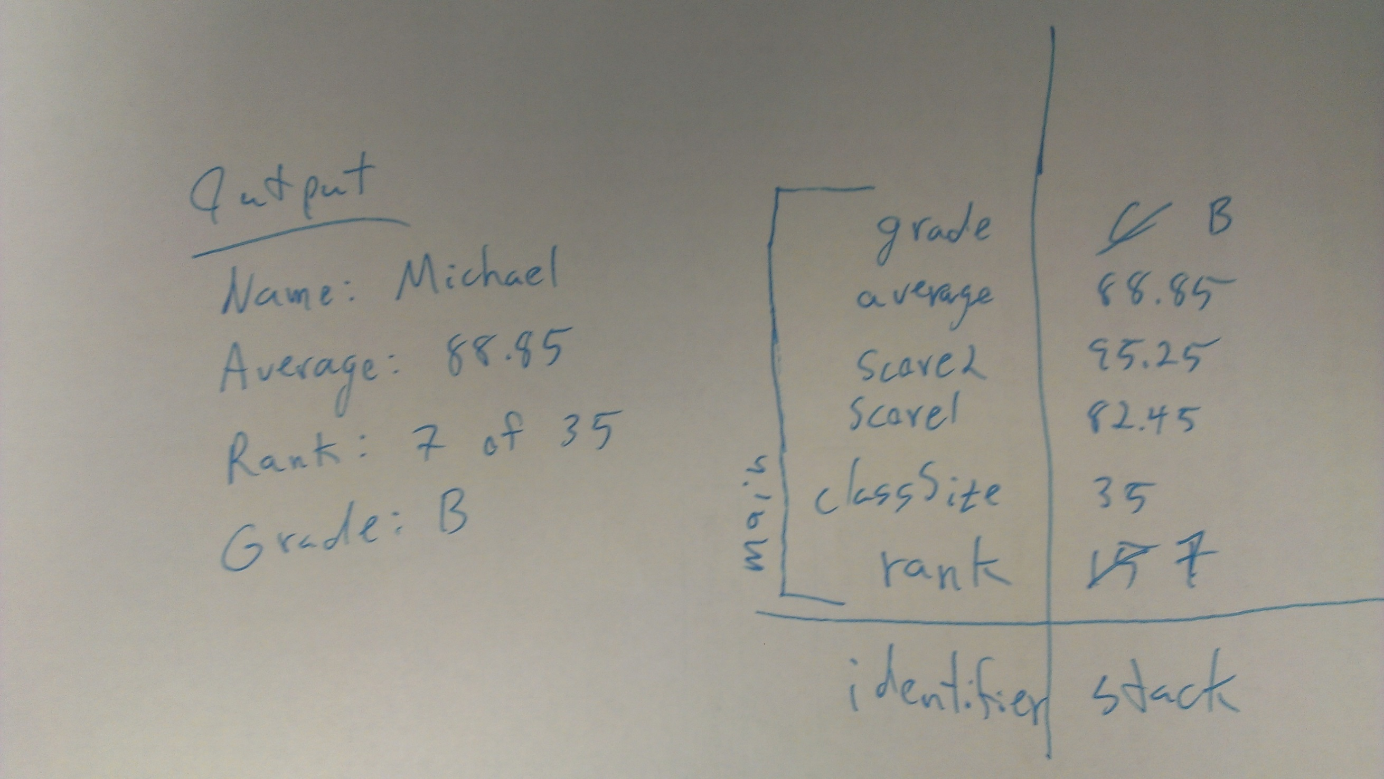

Slide 50
Data Representation Bits
CSCE 121
J. Michael Moore

Slide 51
How Data Is Stored
Byte: a group of 8 bits; 2⁸=256 possibilities
00000000, 00000001, 00000010, 00000011, … , 11111111
Memory: long sequence of locations, each large enough to hold one byte, numbered 0, 1, 2, 3, …
Address: The number of the location
Note: We are using 8 bit addresses for our example to simplify the explanation. Addresses in modern are much longer.
A 32 bit computer has 32 bit addresses.
A 64 bit computer has 64 bit addresses.

Slide 52
How Data Is Stored
bits
1
1
0
0
1
1
0
1
0
0
0
1
1
1
0
1
1
0
0
1
0
0
1
0
0
1
2
3...
bytes
Contents of a location can change
e.g. 01011010 can become 11100001
Use consecutive locations to store longer sequences
e.g. 4 bytes = 1 word

Slide 53
Data Representation Integers
CSCE 121
J. Michael Moore

Slide 54
Binary Numbers
Base Ten Numbers (Integers)
characters
0 1 2 3 4 5 6 7 8 9
5401 is 5x10³ + 4x10² + 0x10¹ + 1x10⁰
Binary numbers are the same
characters
0 1
1011 is 1x2³ + 0x2² + 1x2¹ + 1x2⁰

Slide 55
Converting Binary to Base 10
2³ = 8
2² = 4
2¹ = 2
2⁰ = 1
1001₂ = ____₁₀ =
1x2³ + 0x2² + 0x2¹+ 1x2⁰ =
1x8 + 0x4 + 0x2 + 1x1 =
8 + 0 + 0 + 1 =
9₁₀
0110₂ = ____₁₀ (Try yourself)
0110₂ = 6₁₀

Slide 56
Converting Base 10 to Binary
2⁸ = 256
2⁷ = 128
2⁶ = 64
2⁵ = 32
2⁴ = 16
2³ = 8
2² = 4
2¹ = 2
2⁰ = 1
388₁₀ = ____₂
388 - 2⁸ = 132
132 - 2⁷ = 4
4 - 2² = 0
2⁸
2⁷
2⁶
2⁵
2⁴
2³
2²
2¹
2⁰
1
1
0
0
0
0
1
0
0

Slide 57
Converting Base 10 to Binary
388₁₀ = ____₂
388₁₀ / 2 = 194₁₀ Remainder 0
194₁₀ / 2 = 97₁₀ Remainder 0
97₁₀ / 2 = 48₁₀ Remainder 1
48₁₀ / 2 = 24₁₀ Remainder 0
24₁₀ / 2 = 12₁₀ Remainder 0
12₁₀ / 2 = 6₁₀ Remainder 0
6₁₀ / 2 = 3₁₀ Remainder 0
3₁₀ / 2 = 1₁₀ Remainder 1
2⁸
2⁷
2⁶
2⁵
2⁴
2³
2²
2¹
2⁰
1₁₀ / 2 = 0₁₀ Remainder 1
1
1
0
0
0
0
1
0
0

Slide 58
Other common number representations
Octal Numbers
characters
0 1 2 3 4 5 6 7 8
7820 is 7x8³ + 8x8² + 2x8¹ + 0x8⁰
4112 (base 10)
Hexadecimal Numbers
characters
0 1 2 3 4 5 6 7 8 9 A B C D E F
2FD6 is 2x16³ + Fx16² + Dx16¹ + 6x16⁰
12,246 (base 10)
http://www.kaagaard.dk/service/convert.htm
Note: We will not ask you to do number conversions on the exam.

Slide 59
Negative Numbers
Can we store a negative sign?
What can we do?
Use a bit
Negative: leftmost bit set to 1
Positive: leftmost bit set to 0
Most common is two’s complement

Slide 60
Representing Negative Numbers
Two’s Complement
To convert binary number to its negative…
flip all the bits
change 0 to 1 and 1 to 0
add 1
if the leftmost bit is 0, the number is 0 or positive
if the leftmost bit is 1, the number is negative

Slide 61
Two’s Complement
What is -9?
9 is 00001001 in binary
flip the bits → 11110110
add 1 → 11110111
Addition and Subtraction are easy
always addition
If it is subtraction, first take negative of number being subtracted
Then add!

Slide 62
Two’s Complement
Subtraction
4 - 9 = -5
4 + (-9) = -5 (becomes addition)
00000100 + 11110111 = ?
Flip bits
11111011 → 00000100
Add one → 00000101
Which is 5
Since its positive two’s complement is 5, the number is -5!
0
0
0
0
1
0
0
0
0
0
0
0
1
0
0
1
1
1
1
0
1
1
1
1
1
1
1
1
0
1
1
=
?
Negative since it starts with a 1

Slide 63
Two’s Complement
Subtraction
13 - 9 = 4
13 + (-9) = 4 (becomes addition)
00001101 + 11110111 = ?
But that doesn’t
matter since
we get the
correct answer
anyway
1
1
1
1
1
1
1
1
0
0
0
0
1
1
0
1
This bit is lost
1
1
1
1
0
1
1
1
0
0
0
0
0
1
0
0
=
4

Slide 64
Two’s Complement Range
If we did not use two’s complement and used the left most bit to indicate negative:
Negative 1111111 to positive 1111111
-127 to 127
With two’s complement
-128 to 127
Gain an extra digit in the range.

Slide 65
Ranges of Values
Integer datatypes can be positive or negative
What if you don’t need negative numbers?
short
Max: 32,767
Min: -32,768
Unsigned!!!
unsigned short
Max: 65,535
Min: 0

